Slide 1
CLAS 220 Introduction to Classical Mythology
CLAS 220: Introduction to Classical Mythology
Lecture 5: Iliad 5-8

Slide 2
Quiz Question
Which goddess is wounded by Diomedes in the Iliad?
Artemis
Hestia
Hera
Aphrodite

Slide 3
Quiz Question
2. What is the name of Hector’s wife?
Astyanax
Andromache
Ampelousa
Aristeia

Slide 4
Quiz Question
3. What is the name of Hector’s son?
Astyanax
Scamander
Alexander
Both a. and b.
Both a. and c.

Slide 5
A quick note about names
For many mythological characters, there are two or more ways of spelling their names.
Typically, one is a more accurate transliteration of their name in Greek; the other is filtered through Latin:
Ἀχιλλεύς Akhilleus Achilles
Αἴας Aias Ajax
Ἀνδρομάχη Andromakhe Andromache Οἰδίπους Oidipous Oedipus
We’ll encounter both kinds of names in different translations, so you need to be familiar with both. I use both in the slides for practice.

Slide 6

The Basic Plot of the Iliad

Slide 7
… in other words:
Achilles has withdrawn from battle
the Greeks continue to fight without him,
but cannot win without him.
These books are about the Greek struggle to win without Achilles,
or to get him back into battle
They magnify Achilles’ kleos, since the Greeks can’t win without him, but also give kleos to the other heroes who try to defend the Greeks in his absence
(and on a smaller scale to each hero who dies).

Slide 8


Memorial
SCAMANDRIUS the hunter
Knew every deer in the woods
He used to hear the voice of Artemis
Calling out to him in the lunar
No man’s land of the mountains
She taught him to track her animals
But impartial death has killed the killer
Now Artemis with all her arrows can’t help him up
His accurate firing arm is useless
Menelaus stabbed him
One spear-thrust through the shoulders
And the point came out through the ribs
his father was Strophius…
Alice Oswald, Memorial (2011)

Slide 9
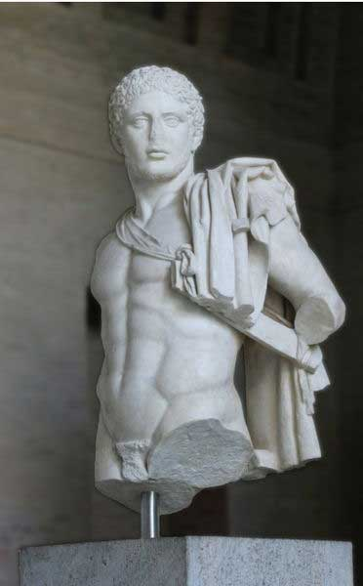
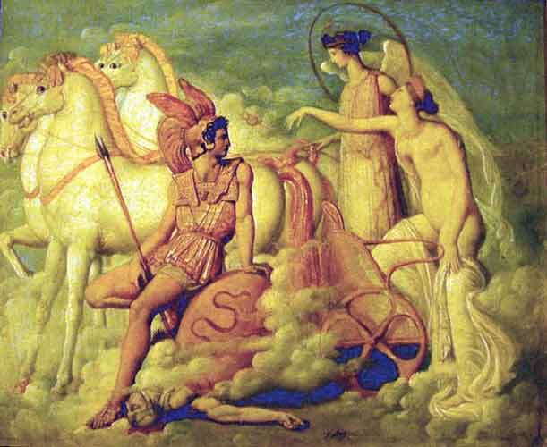
Diomedes’ Hour
Now Diomedes’ hour for great action came,
Athena made him bold, and gave him ease
To tower amid Argives, to win glory,
And on his shield and helm she kindled fire
Most like midsummer’s purest flaming star
In heaven rising, bathed by the Ocean stream.
So fiery she made his head and shoulders
As she impelled him to the center where
The greatest number fought.
Iliad 5. 1-9
Now from the goddess that immortal fluid,
Ichor, flowed – the food of blissful gods
Who eat no food, who drink no tawny wine,
And thereby being bloodless have the name
Of being immortal.
Iliad 5. 392-6

Slide 10
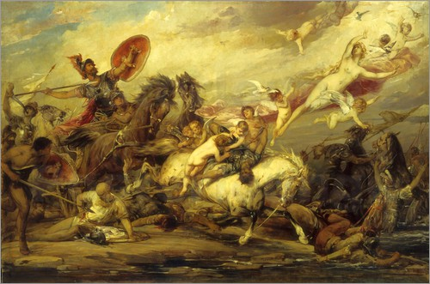
Aphrodite Injured
He smiled at this, the father of gods and men,
And said to the pale-gold goddess Aphrodite:
“Warfare is not for you, child. Lend yourself
To sighs and longing and the marriage bed.
Let Ares and Athena deal with war.”
These were the colloquies in heaven.
5.489-94

Slide 11
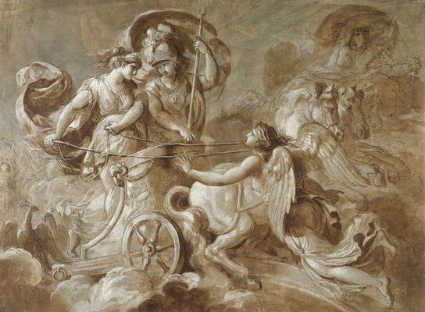
Hera and Athena help the Greeks
Now Hera,
Seeing these Argives perish in the fight,
Appealed with indignation to Athena:
“A dismal scene, this. O untiring goddess,
Daughter of mighty Zeus who bears the stormcloud,
Our word to Menelaus was a fraud –
That he should never sail for home
Before he plundered Ilion! How likely,
If we allow this lunatic attack
By that sinister fool Ares? Come,
We’ll put our minds on our own fighting power!”
5.807-17

Slide 12
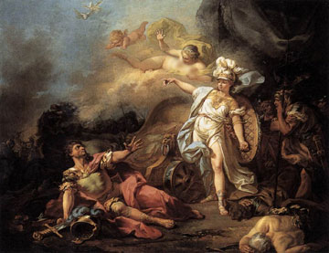
Ares Injured
But Zeus who masses cloud
Regarded him with furrowing brows and said:
“Do not come whining here, you two-faced brute,
Most hateful to me of all the Olympians.
Combat and brawling are your element.
This beastly, incorrigible truculence
Comes from your mother, Hera, whom I keep
But barely in my power, say what I will.
5.1012-19

Slide 13
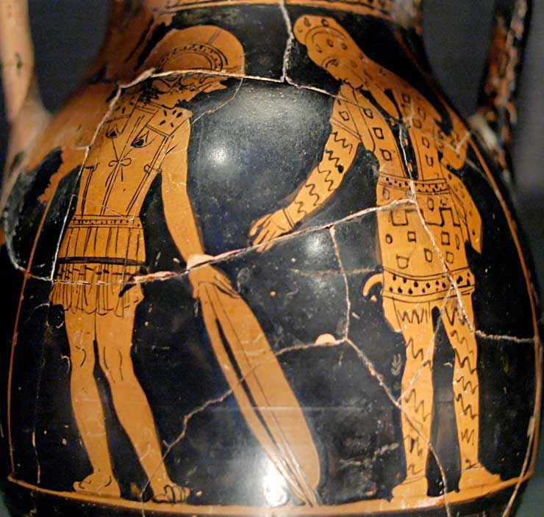
“Like leaves upon this earth”
Hippolokhos’ distinguished son [Glaukos] replied:
“Why ask my birth, Diomedes? Very like leaves
Upon this earth are the generations of men –
Old leaves, cast on the ground by wind, young leaves
The greening forest bears when spring comes in.
So mortals pass; one generation flowers
Even as another dies away.
If you are really bent on knowing all –
And many others know my story – listen…
Iliad 6. 167-75

Slide 14
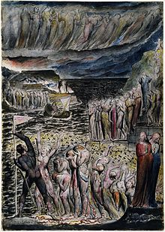
“Like leaves upon this earth”
Virgil, Aeneid VI.403-13
“And here a multitude was rushing…
thick as the leaves that with the early frost of autumn
drop and fall within the forest…they stand: each
pleads to be the first to cross the stream”
Dante, Inferno III.112-17:
“As,
in the autumn, leaves detach themselves, first one and
then the other, till the bough sees all its fallen garments
on the ground, similarly, the evil seed of Adam descended
from the shoreline one by one.…”

Slide 15
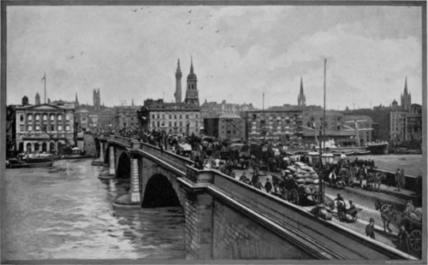
“Like leaves upon this earth”
T.S. Eliot, The Waste Land (1922),
lines 60-68
Unreal City,
Under the brown fog of a winter dawn,
A crowd flowed over London Bridge, so many,
I had not thought death had undone so many.
Sighs, short and infrequent, were exhaled,
And each man fixed his eyes before his feet.
Flowed up the hill and down King William Street,
To where Saint Mary Woolnoth kept the hours
With a dead sound on the final stroke of nine.

Slide 16
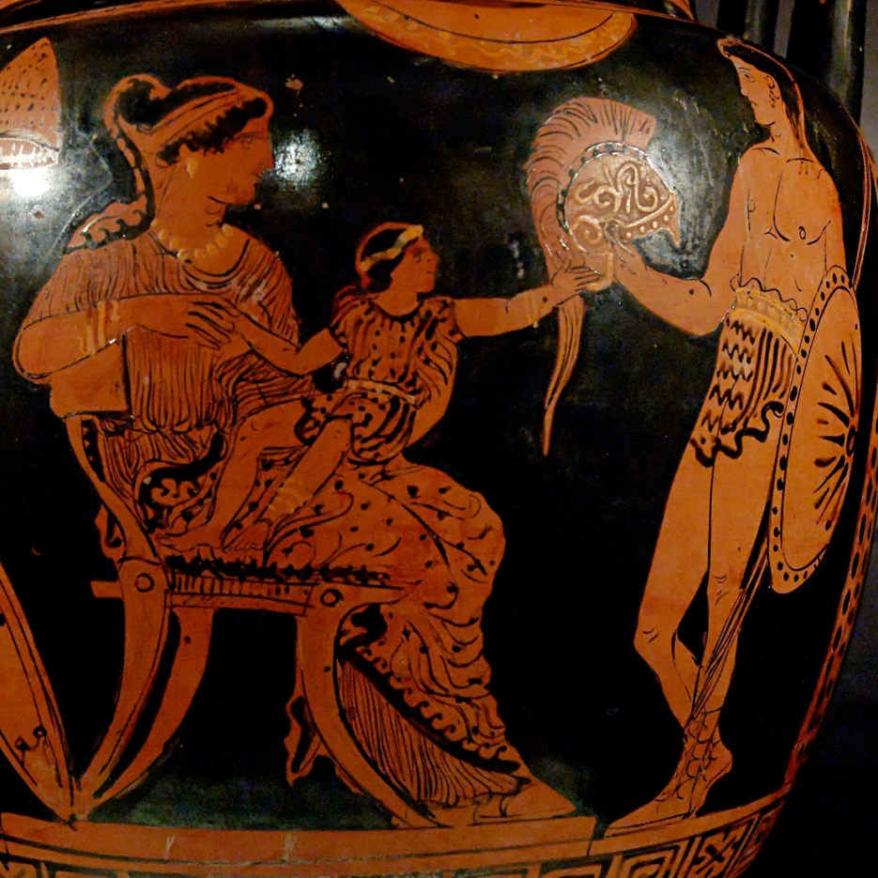
A Soldier’s Farewell to family
As he said this, Hektor held out his arms
To take his baby. But the child squirmed round
On the nurse’s bosom and began to wail,
Terrified by his father’s great war helm –
The flashing bronze, the crest with horsehair plume
Tossed like a living thing at every nod.
His father began laughing, and his mother
Laughed as well. Then from his handsome head
Hektor lifted off his helm and bent
To place it, bright with sunlight, on the ground.
When he had kissed his child and swung him high
To dandle him, he said this prayer: “O Zeus
And all immortals, may this child, my son,
Become like me a prince among the Trojans.
Let him be strong and brave and rule in power
At Ilion; then someday men will say
‘This fellow is far better than his father!’
Seeing him home from war, and in his arms
The bloodstained gear of some tall warrior slain –
Making his mother proud” (Iliad 6.541-560)

Slide 17
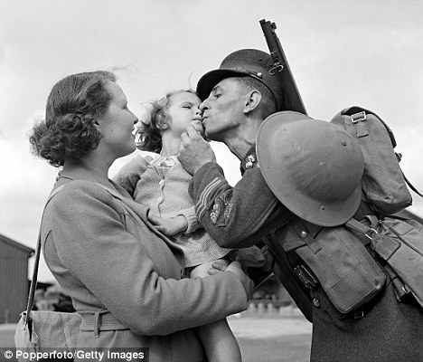
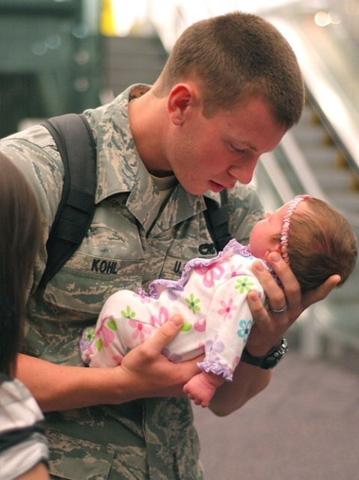
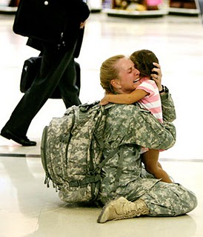
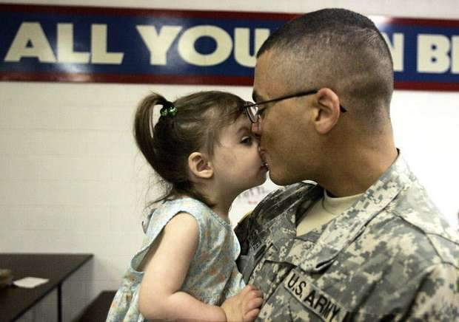
A Soldier’s farewell to family

Slide 18
Quiz Question
4. Which two heroes fight in the second one-on-one battle in the Iliad?
Nestor and Priam
Castor and Pollux
Hector and Ajax
Achilles and Paris

Slide 19
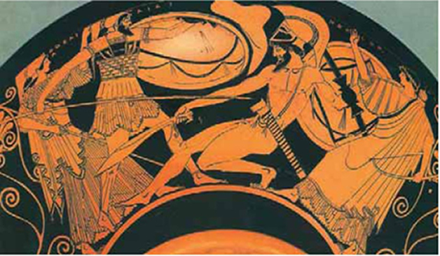
Hector offers a Duel
And if I kill this man, if Lord Apollo
Grants me victory, his helm and shield
I shall unstrap and bring to Ilion
To hang before the Archer Apollo’s shrine.
But his dead body I’ll restore
To your encampment by the well-trimmed ships.
Akhaians there may give him funeral
And heap a mound for him by Helle’s water.
One day a man on shipboard, sailing by
On the winedark sea, will point landward and say:
“There is the death-mound of an ancient man,
A hero who fought Hektor and was slain.”
Someone will say that someday. And the honor
Won by me here will never pass away.”
Iliad 7. 91-105

Slide 20
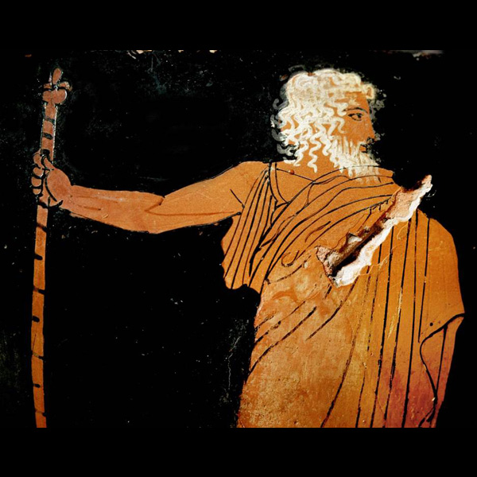
Nestor Remembers
“Ah, what distress for our Achaean land!
How Peleus, the old master of horse, would grieve,
That noble counselor of Myrmidons!
One day, questioning me in his own hall,
He took delight in learning of the Argives’
Lineage and birth. If he should hear
How every man here quails before Hektor now,
He’d lift his arms to the immortal gods
And pray to quit his body, to go down
Into the house of death! O father Zeus,
Athena and Apollo! Could I be young again
As in those days of fighting by the rapids
Of Keladon…
Iliad 7. 143-54

Slide 21
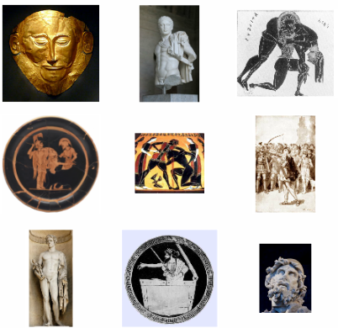
Nine Heroes Volunteer
So chided by the old man, volunteers
Arose then, nine in all – first on his feet
Being Lord Marshall Agamemnon, second
Diomedes, powerful son of Tydeus,
And, joining these, the two who were called Aias,
Rugged impetuous men, and joining these
Idomeneus, and that lord’s right-hand man,
Meriones, the peer of the battle-god
In butchery of war; along with these
Eurypylos, Euaimon’s handsome son,
Thoas Andraimonides, and Odysseus. These were all willing to encounter Hektor
In single combat.

Slide 22
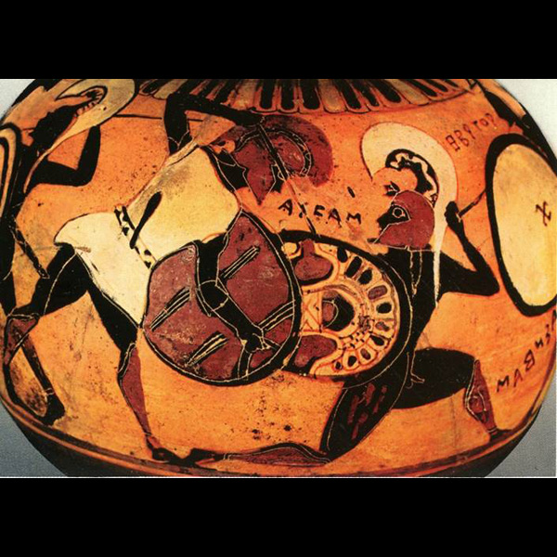
Another inconclusive single combat
Idaios and Talthybios kept their heads.
They held their staves out, parting the contenders,
And that experienced man, Idaios, said:
“Enough, lads. No more fighting. The lord Zeus,
Assembler of bright cloud, cares for you both.
Both are great spearmen, and we all know it.
But now already night is coming on,
And we do well to heed the fall of night.”
7. 325-32

Slide 23
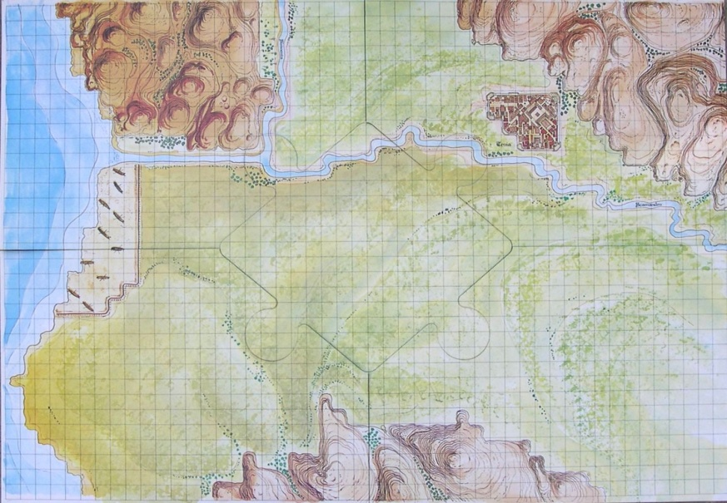
Greeks and Trojans hold councils
Nestor: “We’ll bring
Earth for a single mound about the fire,
Common earth from landward; based on this,
A line of ramparts to defend our ships
And troops – with gates well fitted in the walls
to leave a way out for our chariots” (7.397-402)
Paris:
To all you Trojan handlers of fast horses
Here is my speech: I say ‘No’ to your face:
I will not give the woman up! The treasure,
All that I once brought home from Argos, though,
I offer willingly, and with increment.” (7.427-431)

Slide 24
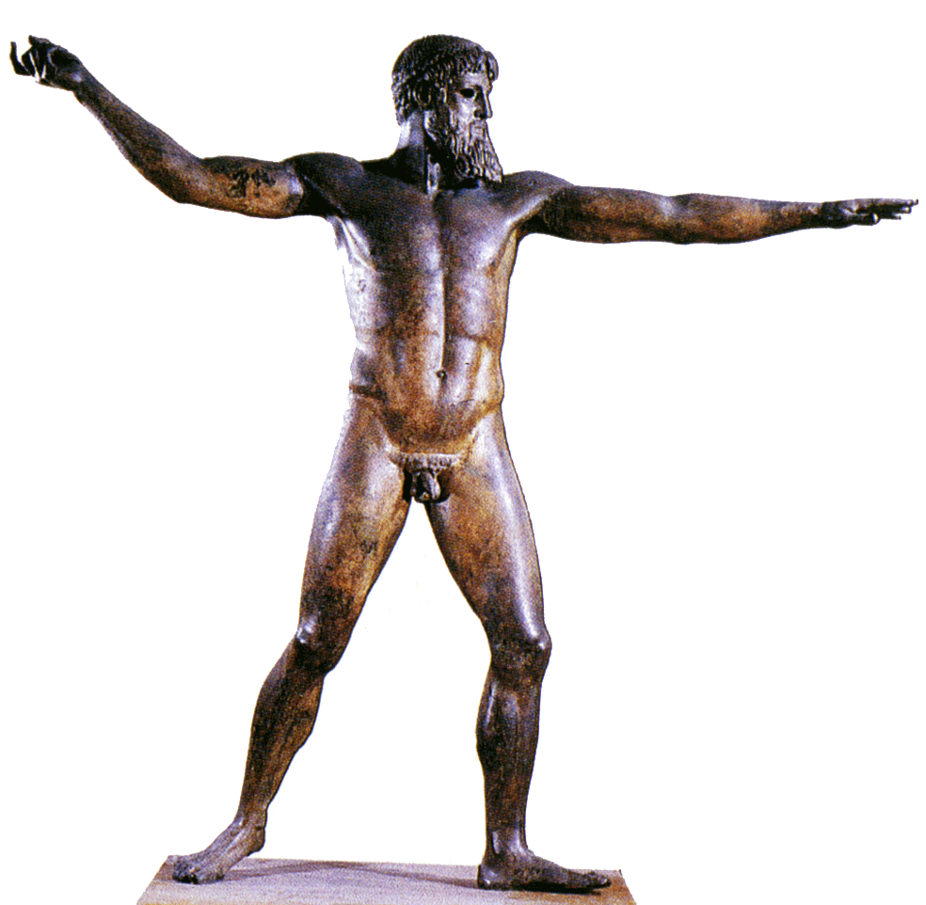
Zeus Intervenes
“Listen to me, immortals, every one,
And let me make my mood and purpose clear.
Let no one, god or goddess, contravene
My present edict; all assent to it
That I may get this business done, and quickly.
If I catch sight of anyone slipping away
With a mind to assist the Danaans or the Trojans,
He comes back blasted without ceremony,
Or else he will be flung out of Olympos
Into the murk of Tartaros that lies
Deep down in underworld. Iron the gates are,
Brazen the doorslab, and the depth from hell
As great as heaven’s utmost height from earth.
You may learn then how far my power
Puts all gods to shame. Or prove it this way:
Out of the zenith hang a golden line
And put your weight on it, all gods and goddesses.
You will not budge me earthward out of heaven,
Cannot budge the all-highest, mighty Zeus,
No matter how hard you try.”
8. 4-24

Slide 25
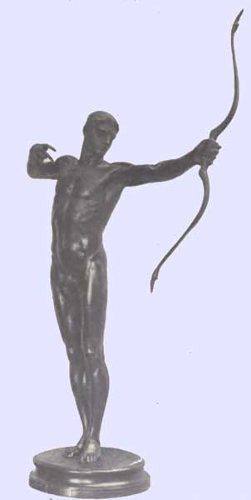
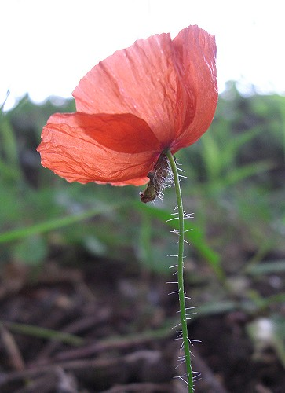
Teucer, in his finest hour, slays Gorgythion
He missed once more, but did hit in the chest
A noble son of Priam, Gorgythion,
Whom Kastianera of Aisyme bore,
A woman tall in beauty as a goddess.
Fallen on one side, as on the stalk
A poppy falls, weighed down by showering spring,
Beneath his helmet’s weight his head sank down.
8.344-350

Slide 26
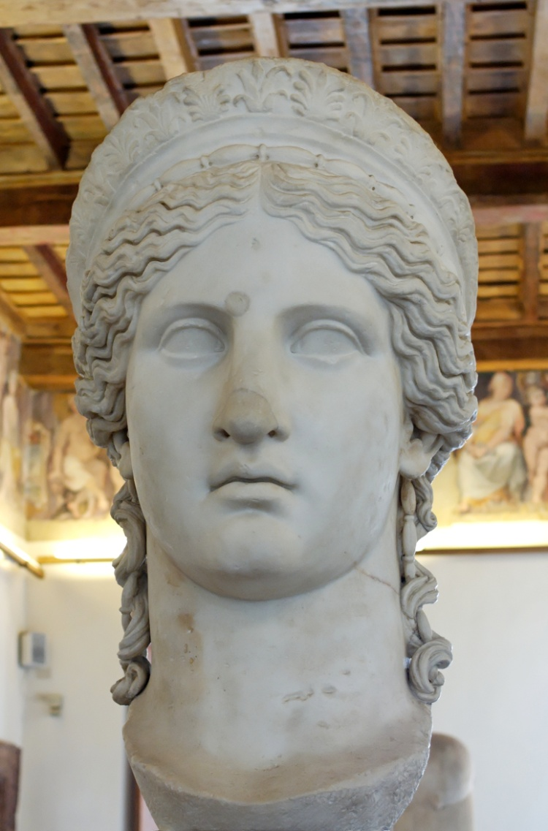
Hera and Athena’s failed rebellion
“At dawn tomorrow you will see still more,
My wide-eyed lady, if you care to see
The Lord Zeus in high rage scything that army
Of Argive spearmen down – for Hektor shall not
Give his prowess respite from the war
Until the marvelous runner, son of Peleus,
Rouses beside his ship – when near at hand,
Around the sterns, in a desperate narrow place,
They fight over Patroklos dead. That way
The will of heaven lies.” 8. 532-41

Slide 27
Quiz Question
5. Which mortal human injures Ares in the Iliad?
Diomedes
Hector
Ajax
Menelaus

